Slide 1
In the selected time range, display:
The fill level of the city water tank
Goals: range, filter
The number of open valve
Goals: last
HINT: group, sum
The most recent state of each valve. Use a green “1” to represent an open valve and a red “0” when is closed
Goals: last, custom function
☆
☆☆☆☆
☆☆☆
The difference between the average water levels in two consecutive windows of one minute.
Goals: join, aggregateWindow, map
HINT: timeShift
The sum of the level of the 4 Tanks A1, A2, B1 and B2
Goals:aggregateWindow, map, and pivot
The fill level of each tank down sampled to 1 min
Goals: aggregateWindow
☆☆☆☆
☆☆
GAIN INDEPENCENCE
Requirements
The speed of the pump that refills the city water tank
Goals: range, filter
The total flow rate from
Goals: last
HINT: group, sum
The flow rate of each valve
Goals: last
☆
☆☆☆☆
☆☆

Slide 2
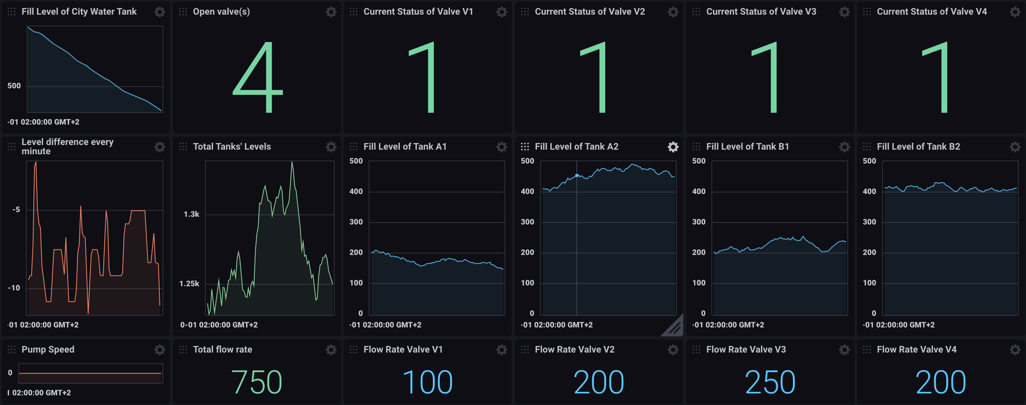
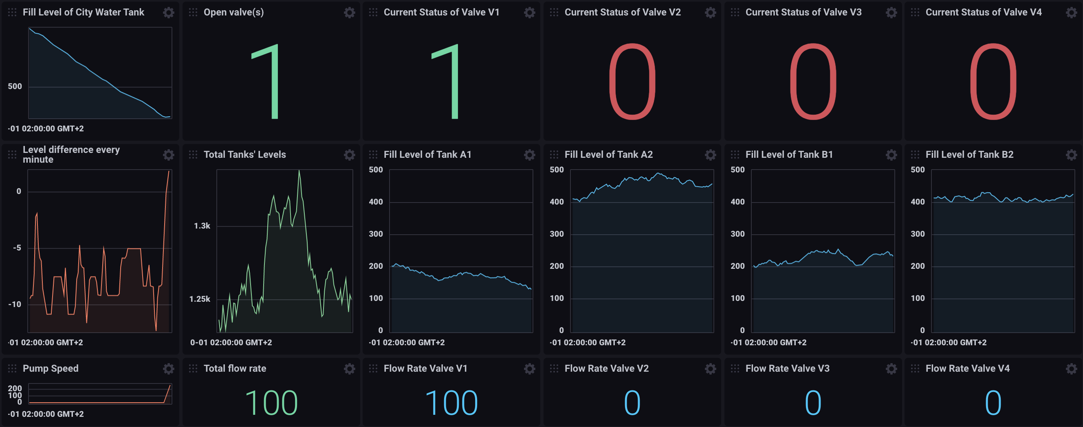
Start: 2020-07-21 08:00:00.000 (GMT-4) - Stop: 2020-07-21 09:30:00.000 (GMT-4)
Test cases
Start: 2020-07-21 08:00:00.000 (GMT-4) - Stop: 2020-07-21 09:40:00.000 (GMT-4)

